Slide 1
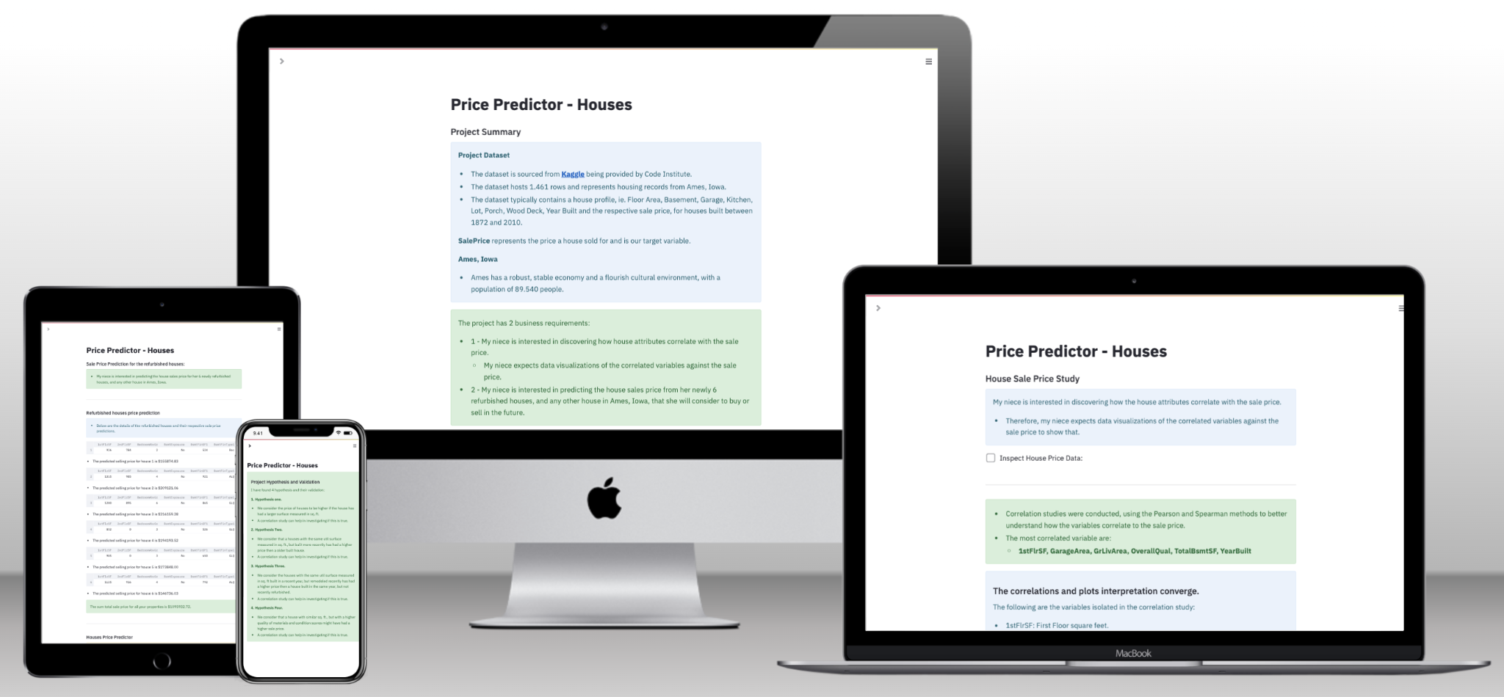

Hackathon Project Title
A brief Description of your project.
Your Name
Notes:
Team Lead: Hi everyone. We are TEAM NAME composed of myself, Dev2 and Dev 3. We’d like to talk about our project PROJECT NAME TECHSTACK(HTML/BOOTSTRAP/JS/CSS/API) & TAGLINE

Slide 2
Planning & Design
Ideation
Design
Technologies
Project Goal: Build interactive dashboards for data analysis.
Use Cases: Insurance cost analysis, customer churn prediction, sales trends, car pricing.
Business Case: Improve decision-making through data insights.
Target Audience: Business professionals, analysts, and decision-makers.
User Stories: "As an analyst, I want to explore trends dynamically."
Intuitive UI: Clean layouts, easy navigation.
Accessibility: Readable colours, labeling
Interactivity: Clickable filters, zoomable charts.
Hypothesis: I think an increase in variable x will result in an increase for variable y
Tools: Power BI, Tableau.
Wireframing: Power BI templates, Figma.
Project Management: Trello, GitHub Projects.
Version Control: GitHub for collaboration.
Libraries & Frameworks: Python (Pandas, NumPy), SQL, Power BI.
Notes:
Team Lead discusses the following 1 minute

Slide 3
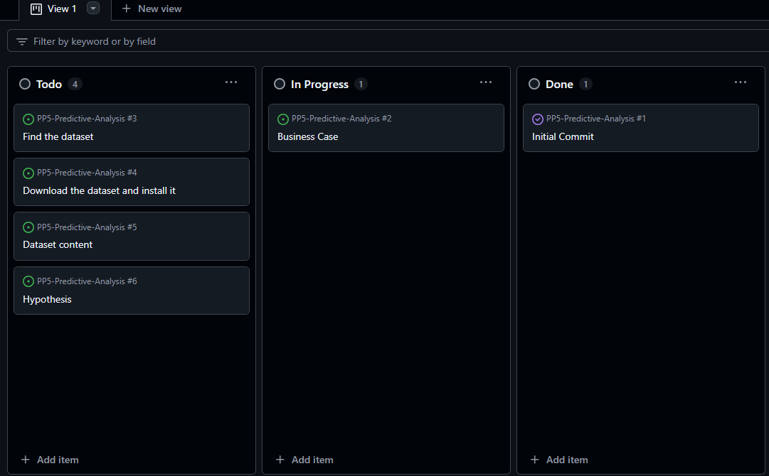
Project Board
Number of User Stories Assigned Tasks
MoSCoW Prioritisation
AGILE (MVP)
Project Backlog
Notes:
Team Lead discusses the Project board 30 seconds! Introduces Dev 2

Slide 4
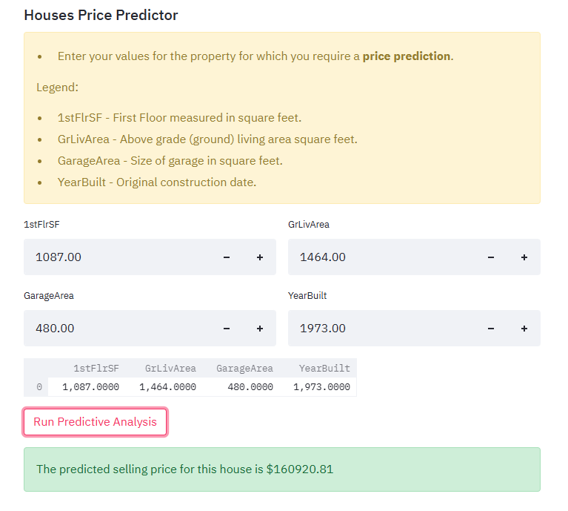
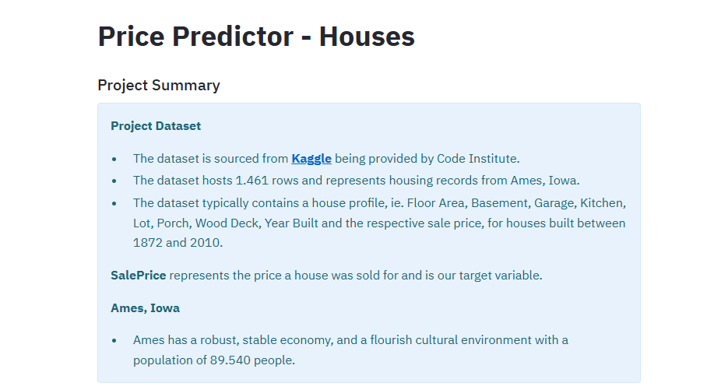
Features
Feature 1
Feature 2
Notes:
Dev 2 Discuss the MAIN FEATURES OF THE APP AT A HIGH LEVEL 1 minute

Slide 5
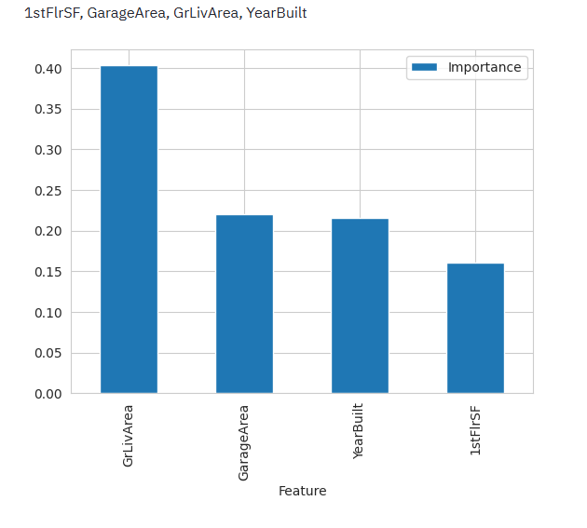
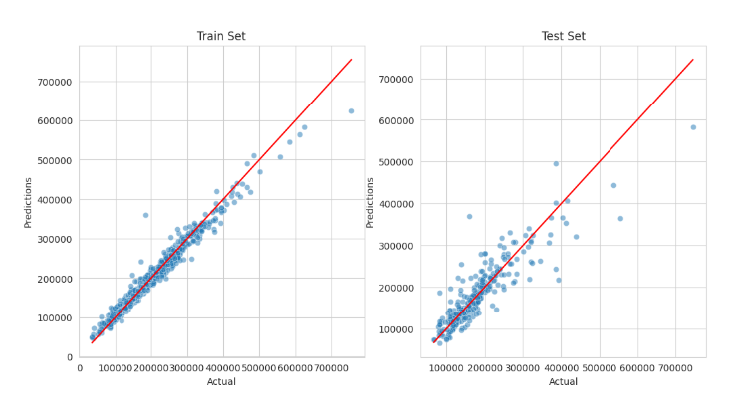
Features
Feature 3
Feature 4
Notes:
DEV 2 Discusses secondary and tertiary features in this slide. Introduces DEV 3

Slide 6
Documentation, Testing & Version Control
GitHub Repository:
Notes:
Dev 3 then opens Repo, and exhibits README touching on testing and deployment

Slide 7
Insights & Findings
Key Data Insights
Healthcare Insurance Analysis:
Age, BMI, and smoking status significantly impact insurance costs.
Geographic regions show cost variations.
Credit Card Churn Analysis:
High-income customers are less likely to churn.
Customers with lower transaction frequency have a higher churn risk.
Retail Sales Trends:
Seasonal trends impact purchasing behavior.
High-value customers contribute significantly to revenue.
Car Price Analysis:
Engine size and brand influence pricing.
Luxury car prices fluctuate with market trends.
Findings & Business Impact
Predictive Models: Forecast trends and risks for better decision-making.
Interactive Dashboards: Enable real-time exploration of key metrics.
Storytelling with Data: Simplifies complex insights for stakeholders.
Actionable Insights:
Insurance companies can adjust pricing strategies.
Banks can target high-risk customers with retention offers.
Retailers can optimize stock based on customer behavior.

Slide 8
Collaboration & Outcomes
Outcomes
Collaboration
Development Problems
Summary
Are you happy with the final product?
What do you hope to achieve in the next development cycle?
What would you do differently if you could start again?
Problems that arose during development?
In group conflicts and resolutions?
Did you find any of the behaviour related content useful? Teamwork, problem solving etc?
Interactivity
Overall group dynamic
Overall satisfaction
What we learned
Our experiences.
Notes:
All 3 Devs could maybe take a card each here.

Slide 9
Collaboration & Outcomes –Ewa
Outcomes
Collaboration
Development Problems
Summary
Are you happy with the final product?
Yes
What do you hope to achieve in the next development cycle?
I would enhance the interactivity of the dashboard
What would you do differently if you could start again?
I would create the initial visualization in Tableau instead of Python
Problems that arose during development?
Technical problems with VS Code
In group conflicts and resolutions?
None
Did you find any of the behaviour related content useful? Teamwork, problem solving etc?
It was helpful to observe how to approach and handle technical issues in a calm manner
Interactivity
My limited knowledge of Tableau slowed down the development process
Overall group dynamic
Satisfactory
Overall satisfaction
Fairly good
What we learned
Team collaboration
Our experiences
Overall positive
Notes:
All 3 Devs could maybe take a card each here.

Slide 10
Collaboration & Outcomes-Selda Sen
Outcomes
Development Problems
Summary
Are you happy with the final product?
Yes
What do you hope to achieve in the next development cycle?
I hope to be able to do this project alone, which we did as a group.
What would you do differently if you could start again?
I wouldn't change anything about the process.
Overall group dynamic
It was excellent
Overall satisfaction
I am satisfied
What we learned
I was able to think more deeply about how data visuals help us. I learned how to connect VsCode and GitHub. I learned how to do things as a team member in a project.
Our experiences.
I realized once again that numbers in a data containing about ten thousand lines do not have a simple meaning. It is easy to find the highest or lowest, but it is quite complicated to understand the relationships of other values, to produce a theory and try to test whether it is true or not. This really requires knowledge and experience.
Problems that arose during development?
While using vscode, we realized that I was using Ewa's space, then we opened my own space. Closing, deleting and re-uploading the file took extra time.
In group conflicts and resolutions?We were a very good group. We did not have any disagreements.
Did you find any of the behaviour related content useful? Teamwork, problem solving etc?Everyone was very helpful. Paul organized us very well by distributing the tasks very well. He also helped us a lot wherever we needed help, using his previous experiences. We did data visualization with Ewa. We exchanged ideas and prepared together. We completed each other in the areas where we were lacking.
Collaboration
Notes:
All 3 Devs could maybe take a card each here.

Slide 11
Q&A
Notes:
Quick q&a 1 question each from the judges and any questions from the group.

